Slide 1
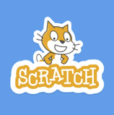
Scratch Programming

Slide 2
Exercise

Slide 3
Exercise

Slide 4
Exercise

Slide 5
Exercise

Slide 6
Exercise

Slide 7
Brain Exercise

Slide 8
Our Brain needs Exercise

Slide 9
Why Programming (can be skipped)
It is important for children to learn programming because they should be active producers rather than passive consumers of technology.
Children can use technology to shape their world and to solve problems that they or their community may face.

Slide 10
Programming and Computational Thinking Skills (can be skipped)
In learning to program on this course, you will learn the following concepts:
Sequencing
Repetition
Variables
Selection

Slide 11
Computational Thinking (can be skipped)
Programming also allows learners to develop many skills, which can be grouped under the umbrella of Computational Thinking. These skills include:
Logical thinking
Designing algorithms
Spotting patterns
Abstraction
Decomposition

Slide 12
Making a cup of tea:
Get cup from shelf
Put tea bag in cup
Fill kettle with water
Turn kettle on
Pour water from Kettle
Add milk
Add sugar

Slide 13
Introduction to Algorithms
Think of a task you complete every day, and write down the sequence of steps you would need to complete it.
As an example, here are some steps that can be used to make a cup of tea:

Slide 14
Drawing a Rectangle:
Take a Pen
Take paper
Draw horizontal line
Turn 90*
Draw vertical line
Turn 90*
Draw horizontal line
Turn 90*
Draw vertical line
Turn 90*

Slide 15
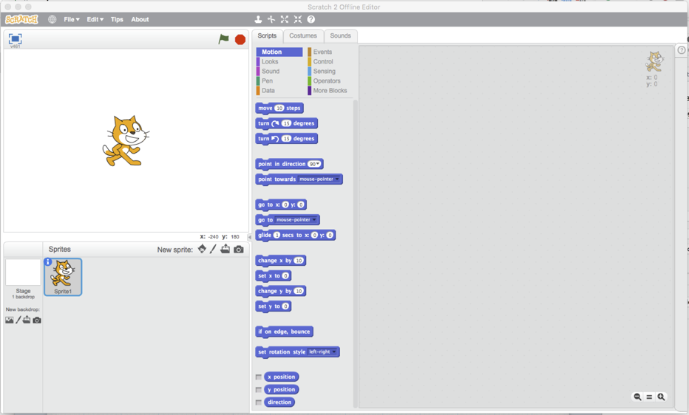
Using Scratch

Slide 16
Download and Install

Slide 17
Drawing Rectangle

Slide 18
Drawing Rectangle (with loop)

Slide 19
Pentagon

Slide 20
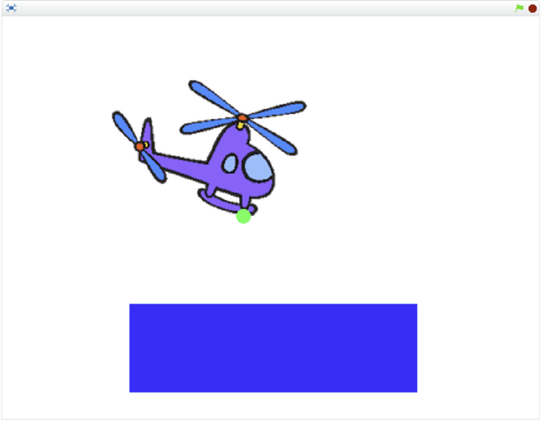
Helicopter Game

Slide 21
Ghostbusters

Slide 22
LostInSpace

Slide 23
boat-race

Slide 24
Physical Computing with Raspberry Pi

